Slide 1


M.Tech Program
Advanced Industry Integrated Programs
Jointly offered by University and LTIMindTree
Review III
Project Title
FinSight: An Evidence-Grounded Financial Filing Analyst powered by Hybrid RAG
Team Member
Dhayanidhi R S
Knowledge partner | Implementation partner

Slide 2
FinSight: An Evidence-Grounded Financial Filing Analyst powered by Hybrid RAG
Introduction
Background & Problem Statement
Company financial filings contain valuable information across lengthy narratives, complex tables, financial statements, and notes. Analysts must manually search, interpret, compare, and verify this information.
Generic document-question-answering systems may:
    confuse fiscal periods, currencies, or presentation units.
    provide answers without precise source evidence.
Proposed System
FinSight combines full-document Hybrid RAG with a structured Financial Fact Ledger to:
    answer natural-language queries and comparisons.
    provide evidence-grounded answers with traceable citations.

Slide 3
FinSight: An Evidence-Grounded Financial Filing Analyst powered by Hybrid RAG
Objectives
Preserve every filing byte-for-byte with verifiable identity, and keep the original immutable
Extract a citable source representation — pages, blocks, tables and footnotes with exact coordinates
Retrieve passages by both wording and meaning, under scope filters that similarity cannot override
Generate answers in which every claim cites the stored source span it rests on
Verify every numeral against the span its own claim cites, and remove any claim that fails
Record every answer, decision and reason for audit.

Slide 4
FinSight: An Evidence-Grounded Financial Filing Analyst powered by Hybrid RAG
Module name
Intake & Storage: Validates untrusted uploads; stores originals content-addressed and immutable.
Extraction: PyMuPDF and Docling produce pages, blocks, tables, cells and footnotes with page coordinates.
Chunking: Structure-aware splitting into focused child passages and broader parent passages.
Indexing: Local embeddings and BM25 term weights written to Qdrant through a transactional outbox.
Retrieval: Keyword and dense search under hard filters, fused by reciprocal rank, reordered by a cross-encoder.
Generation: Schema-constrained model, citation resolution, Evidence Gate, one recorded decision per answer.
Surfaces: Authenticated REST API, Streamlit interface, operator command line.

Slide 5
FinSight: An Evidence-Grounded Financial Filing Analyst powered by Hybrid RAG
Problem Statement
A language model will state a figure that is not in the document.
Generated text is not checkable.
Filings are untrusted input.
Scope cannot be left to similarity.
Arithmetic is not a language task.

Slide 6
FinSight: An Evidence-Grounded Financial Filing Analyst powered by Hybrid RAG
Methodology
Prepare the corpus (once per filing) Validate the file, preserve the original immutably, extract pages, blocks, tables and footnotes with coordinates, split into child units for matching and parent units for context, then index as dense vectors and BM25 term weights.
Retrieve (per question) Keyword and meaning search run together under hard scope filters, combined by reciprocal rank fusion, reordered by a cross-encoder, and de-duplicated so the same evidence is not counted twice.
Generate under constraint The model receives only the selected passages, labelled [1] [2] [3], and must reply in a fixed structure: claims plus the labels each claim rests on. It is instructed not to calculate, and permitted to say the passages do not answer.
Verify before release Code resolves every label back to the stored source text and checks that each figure, scale word and currency in a claim actually appears there. A claim that fails is removed; if nothing survives, the system abstains. Every answer is recorded with its decision and reasons.

Slide 7
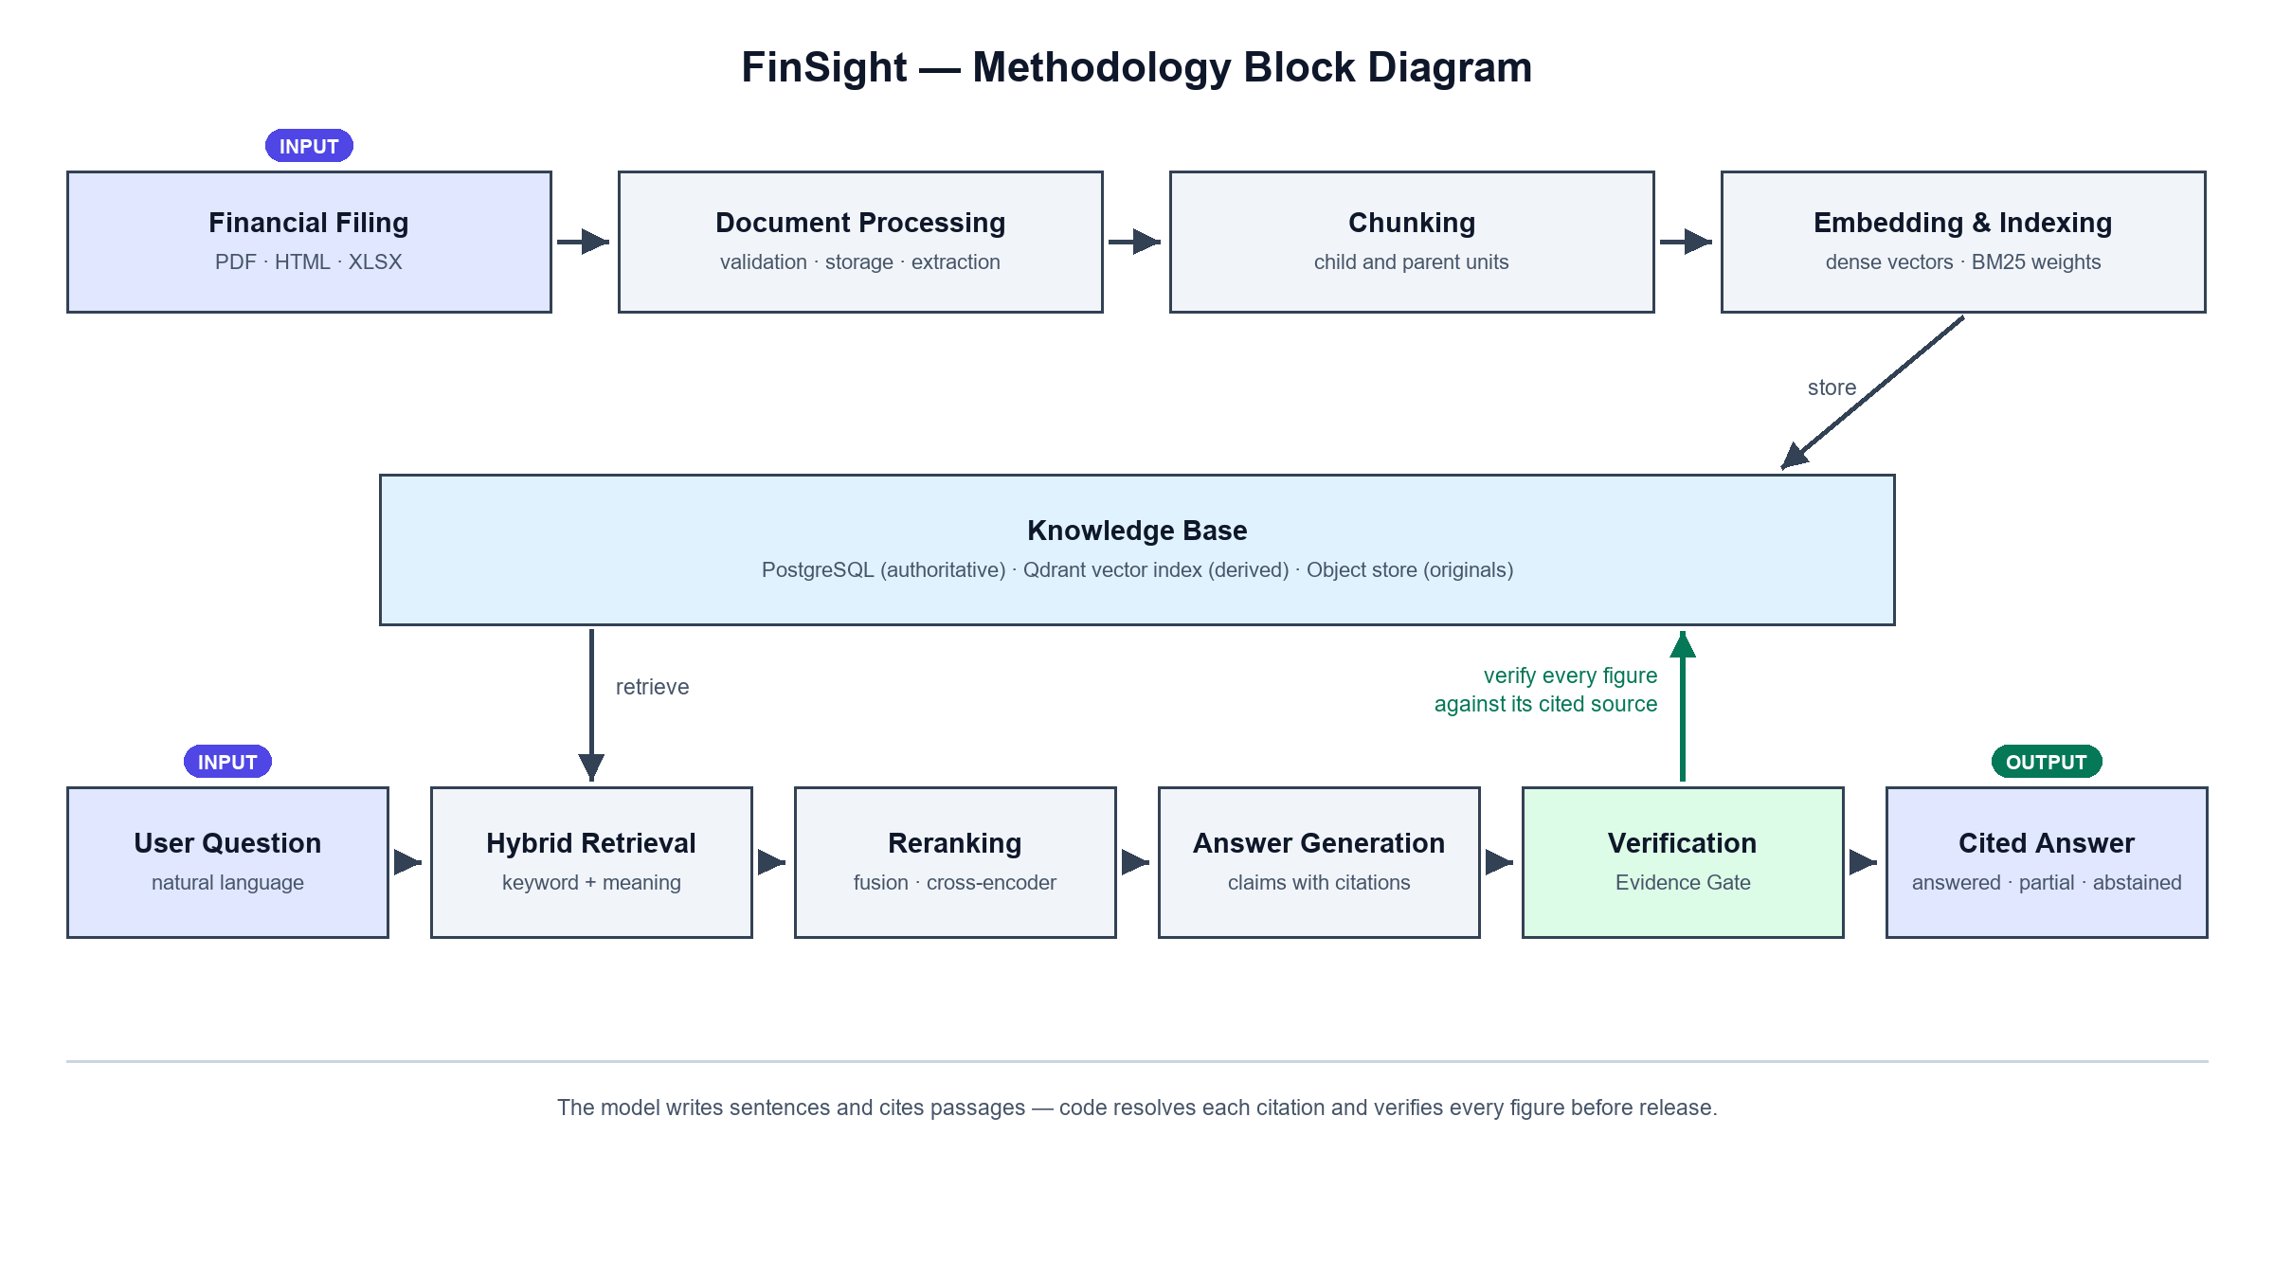
FinSight: An Evidence-Grounded Financial Filing Analyst powered by Hybrid RAG

Slide 8
FinSight: An Evidence-Grounded Financial Filing Analyst powered by Hybrid RAG
Tools & Technology
Layer | Technology
Language | Python 3.12
Authoritative store | PostgreSQL, SQLAlchemy, Alembic
Vector Database & Indexing | Qdrant — dense + BM25 sparse
Object storage | SeaweedFS via the S3 protocol (boto3)
Embeddings | nomic-embed-text via Ollama, 768-dim
Generation | llama3.1:8b via Ollama, host-native
Reranking | ms-marco-MiniLM-L-6-v2 cross-encoder
Parsing & Extraction | PyMuPDF and Docling
API | FastAPI
Interface | Streamlit
Deployment | Docker Compose, single node

Slide 9
FinSight: An Evidence-Grounded Financial Filing Analyst powered by Hybrid RAG
Findings and Results
Filings | 3 (Infosys, HDFC Bank, Ola Electric)
Pages extracted | 1,403
Text blocks | 40,476
Retrievable passages | 5,637
Search index entries | 4,867
Corpus processed
Question over 4 passages | 302 s end to end
Of which the language model | 287 s
Of which all verification | 53 ms
Question with no matching evidence | 1.2 s
A real answered question

Slide 10
FinSight: An Evidence-Grounded Financial Filing Analyst powered by Hybrid RAG
Conclusion
A complete, measured answer pipeline over real filings — 1,403 pages ingested, 5,637 passages indexed, and a question returns prose in which every claim cites the stored span it rests on.
Grounding is affordable. Verification costs 0–53 ms against a 287-second model call, so correctness is not traded against speed.
Design decisions were made on measurement, not intuition — three designs were built, measured and rejected, including one specified in the original blueprint.

Slide 11
FinSight: An Evidence-Grounded Financial Filing Analyst powered by Hybrid RAG
Future Works
Fact Ledger — typed financial records Bounded concept catalogue with value, unit, period, basis and provenance. Unlocks arithmetic, cross-company comparison and trend charts, which prose cannot support.
Evaluation harness and golden question set A fixed question set with known-correct answers enables the first real quality measurement, and threshold gates in CI to prevent regression.
Background processing workers Indexing a filing takes ~40 minutes — longer than any HTTP request. A job queue with progress reporting enables upload through the browser.
GPU-backed inference 0% GPU offload today; the model runs on CPU. Dedicated inference hardware is an order-of-magnitude latency reduction with no code change.
Deployment via AWS EC2 instance or AWS Lambda Integration with S3 Bucket

Slide 12
FinSight: An Evidence-Grounded Financial Filing Analyst powered by Hybrid RAG
Acknowledgement
I sincerely thank:
  My manager and project mentors for their guidance and technical feedback.
  My organization and internship team for the opportunity and resources.
  The open-source communities behind the technologies used in FinSight.
  Everyone who supported the reviews, testing, and refinement of this project.

Slide 13
FinSight: An Evidence-Grounded Financial Filing Analyst powered by Hybrid RAG
Reference
[1] T. Gao, H. Yen, J. Yu, and D. Chen, "Enabling large language models to generate text with citations," in Proc. Conf. Empirical Methods in Natural Language Processing (EMNLP), 2023, pp. 6465–6488.
[2] J. Menick et al., "Teaching language models to support answers with verified quotes," arXiv:2203.11147, 2022.
[3] N. F. Liu et al., "Lost in the middle: How language models use long contexts," Trans. Assoc. Comput. Linguist., vol. 12, pp. 157–173, 2024.
[4] A. Asai, Z. Wu, Y. Wang, A. Sil, and H. Hajishirzi, "Self-RAG: Learning to retrieve, generate, and critique through self-reflection," in Proc. Int. Conf. Learning Representations (ICLR), 2024.
[5] K. Greshake, S. Abdelnabi, S. Mishra, C. Endres, T. Holz, and M. Fritz, "Not what you've signed up for: Compromising real-world LLM-integrated applications with indirect prompt injection," in Proc. 16th ACM Workshop on Artificial Intelligence and Security (AISec), 2023, pp. 79–90.

Slide 14
FinSight: An Evidence-Grounded Financial Filing Analyst powered by Hybrid RAG
Reference
[6] Y. Gao et al., "Retrieval-augmented generation for large language models: A survey," arXiv:2312.10997, 2023.
[7] N. Thakur, N. Reimers, A. Rücklé, A. Srivastava, and I. Gurevych, "BEIR: A heterogeneous benchmark for zero-shot evaluation of information retrieval models," in Proc. NeurIPS Datasets and Benchmarks Track, 2021.
[8] T. Formal, C. Lassance, B. Piwowarski, and S. Clinchant, "From distillation to hard negative sampling: Making sparse neural IR models more effective,” in Proc. 45th Int. ACM SIGIR Conf., 2022, pp. 2353–2359.
[9] Z. Ji et al., "Survey of hallucination in natural language generation,“ ACM Comput. Surv., vol. 55, no. 12, art. 248, pp. 1–38, 2023.
[10] A. Grattafiori et al., "The Llama 3 herd of models," arXiv:2407.21783, 2024.

